Slide 1
Performance of previous methods on AVNRT data
August 2024
Andrea Corrado

Slide 2
Outline
Recap of methods studied so far
Application on AVNRT data
ECG filtering
Spectrogram estimation
Alignment results
Further steps
Other possible routes: Scalogram
Theory
Application on didactical examples
Application on AVNRT data
Conclusions

Slide 3
Outline
Recap of methods studied so far
Application on AVNRT data
ECG filtering
Spectrogram estimation
Alignment results
Further steps
Other possible routes: Scalogram
Theory
Application on didactical examples
Application on AVNRT data
Conclusions

Slide 4
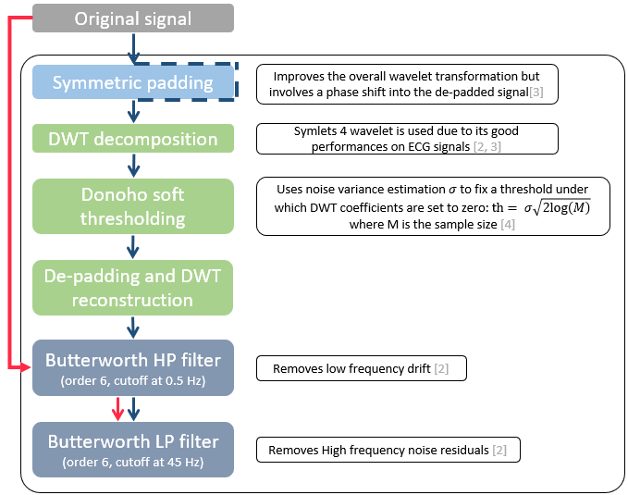
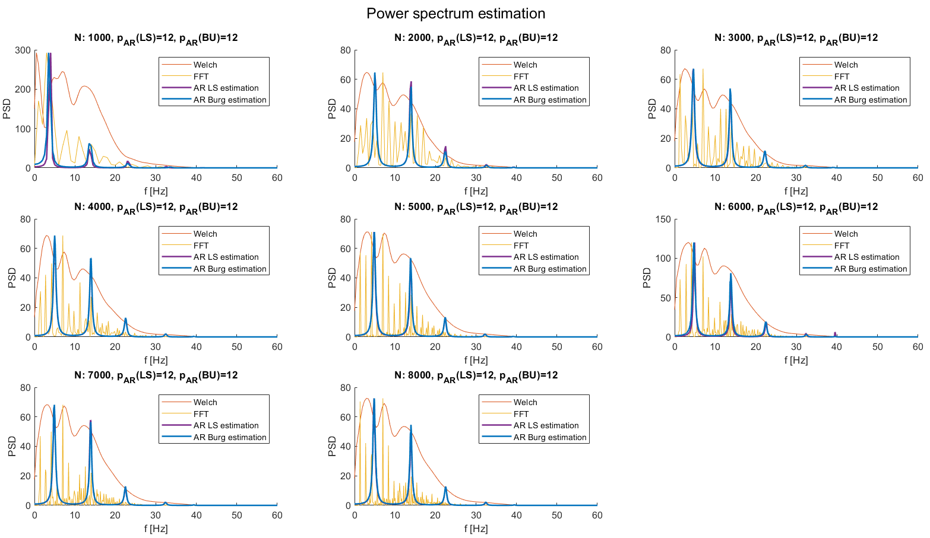
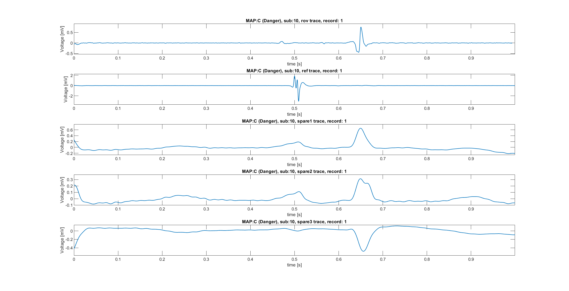
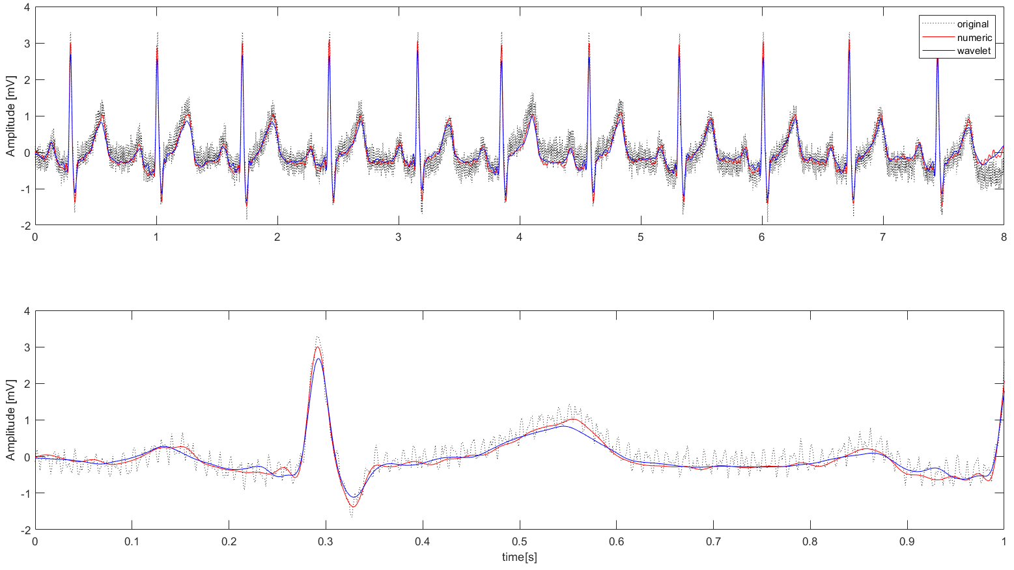
Recap
So far, different methods for different purposes was evaluated:
Filtering ECG signal in a robust way with wavelet thresholding and Band-pass zero-phase filters.
Evaluation of ECG spectrums using AR estimation with LS/Burg estimators
Alignment strategies using other signals (respect to the Rov trace) present into the AVNRT database
Now all these methods will be presented while applied on AVNRT data systematically.
MAP C

Slide 5
Outline
Recap of methods studied so far
Application on AVNRT data
ECG filtering
Spectrogram estimation
Alignment results
Further steps
Other possible routes: Scalogram
Theory
Application on didactical examples
Application on AVNRT data
Conclusions

Slide 6
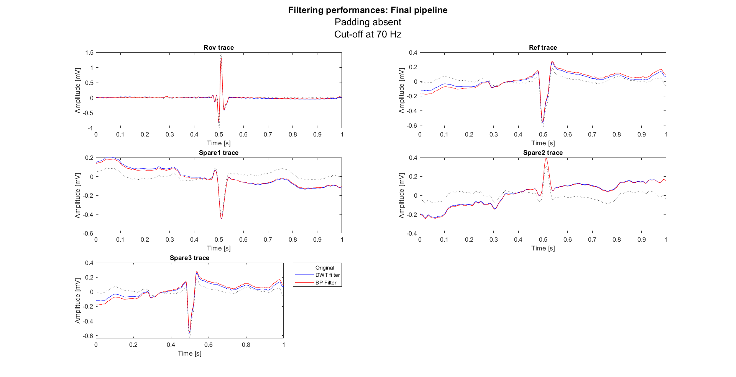
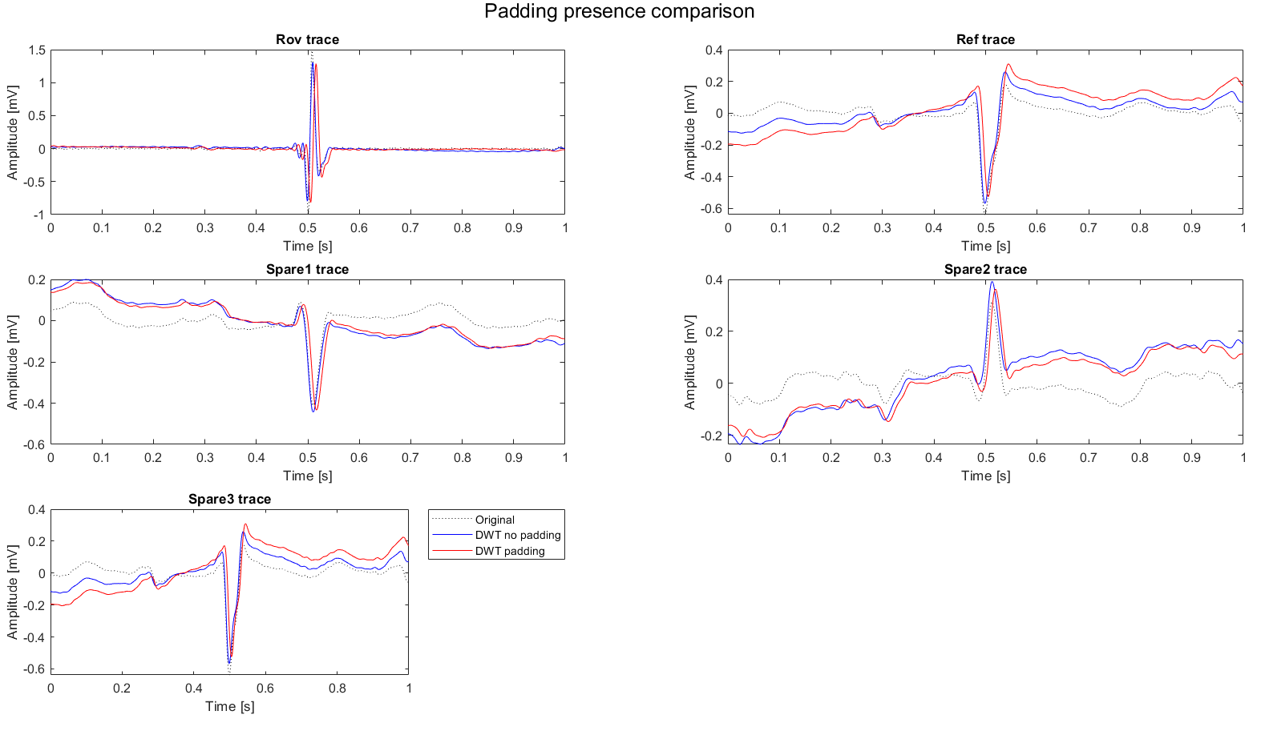
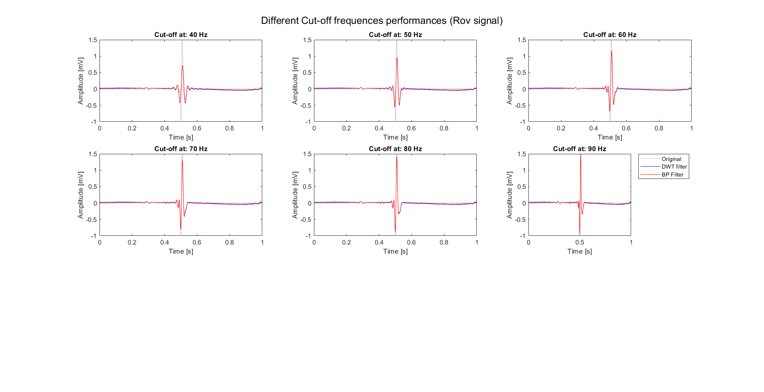
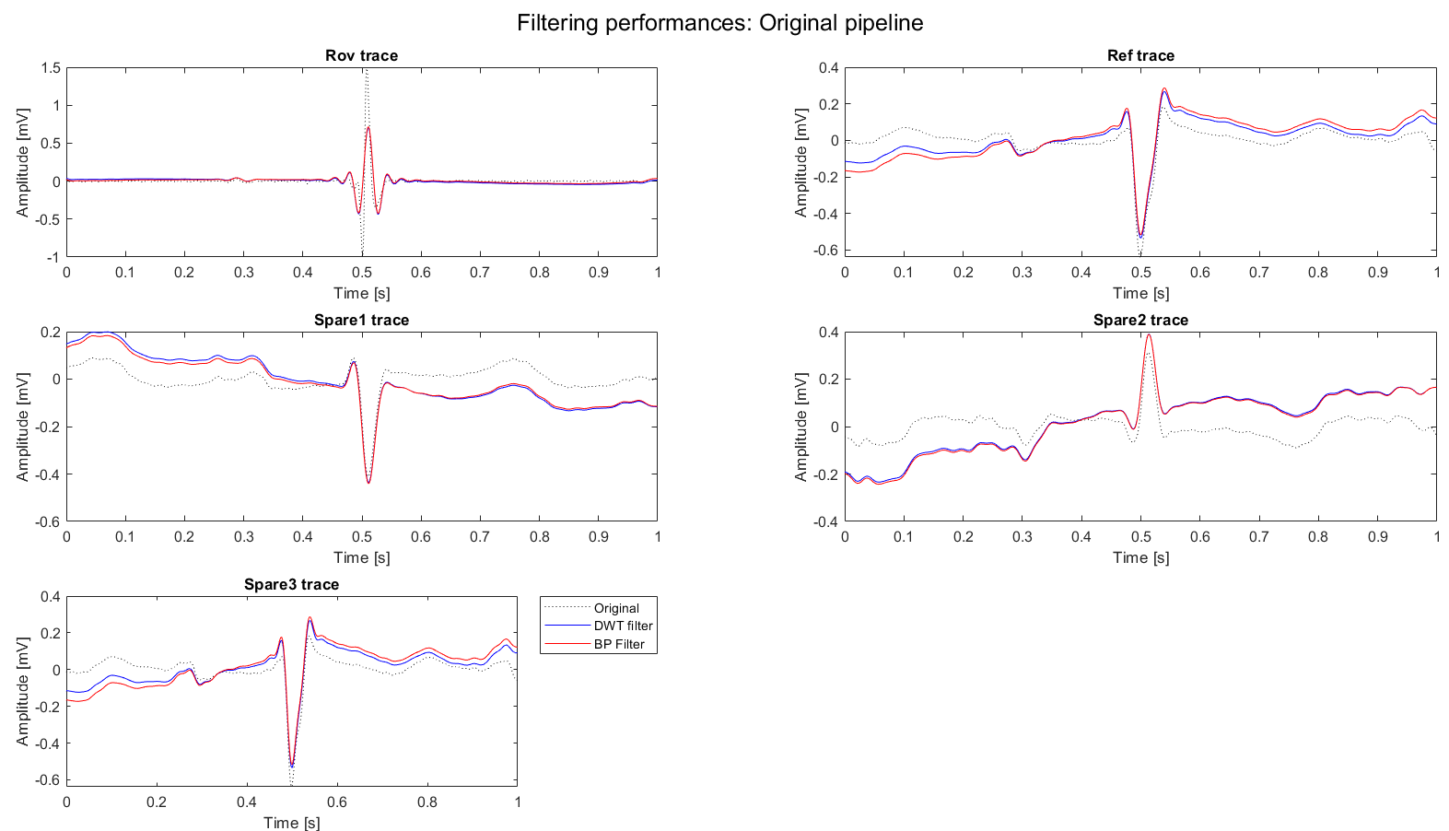
Filtering performance
First, the algorithm proposed was applied as it is.
Limited performances on Rov signals and reference signals (when these are presumably CS signals)
Then other configurations of the same algorithm has been tested:
LP cut-off frequency?
Padding or not?
Little phase shift, not justified filtering performance improvements
In conclusion, the final configuration used was:
No padding
Cut –off (LP) at 70 Hz
Such configuration ensures the best compromise between noise removal and signal preservation.

Slide 7
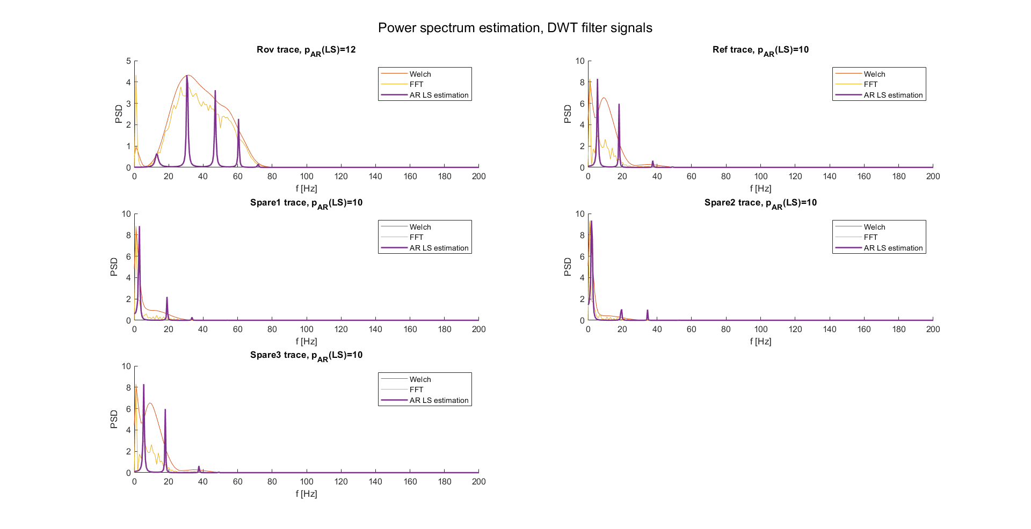
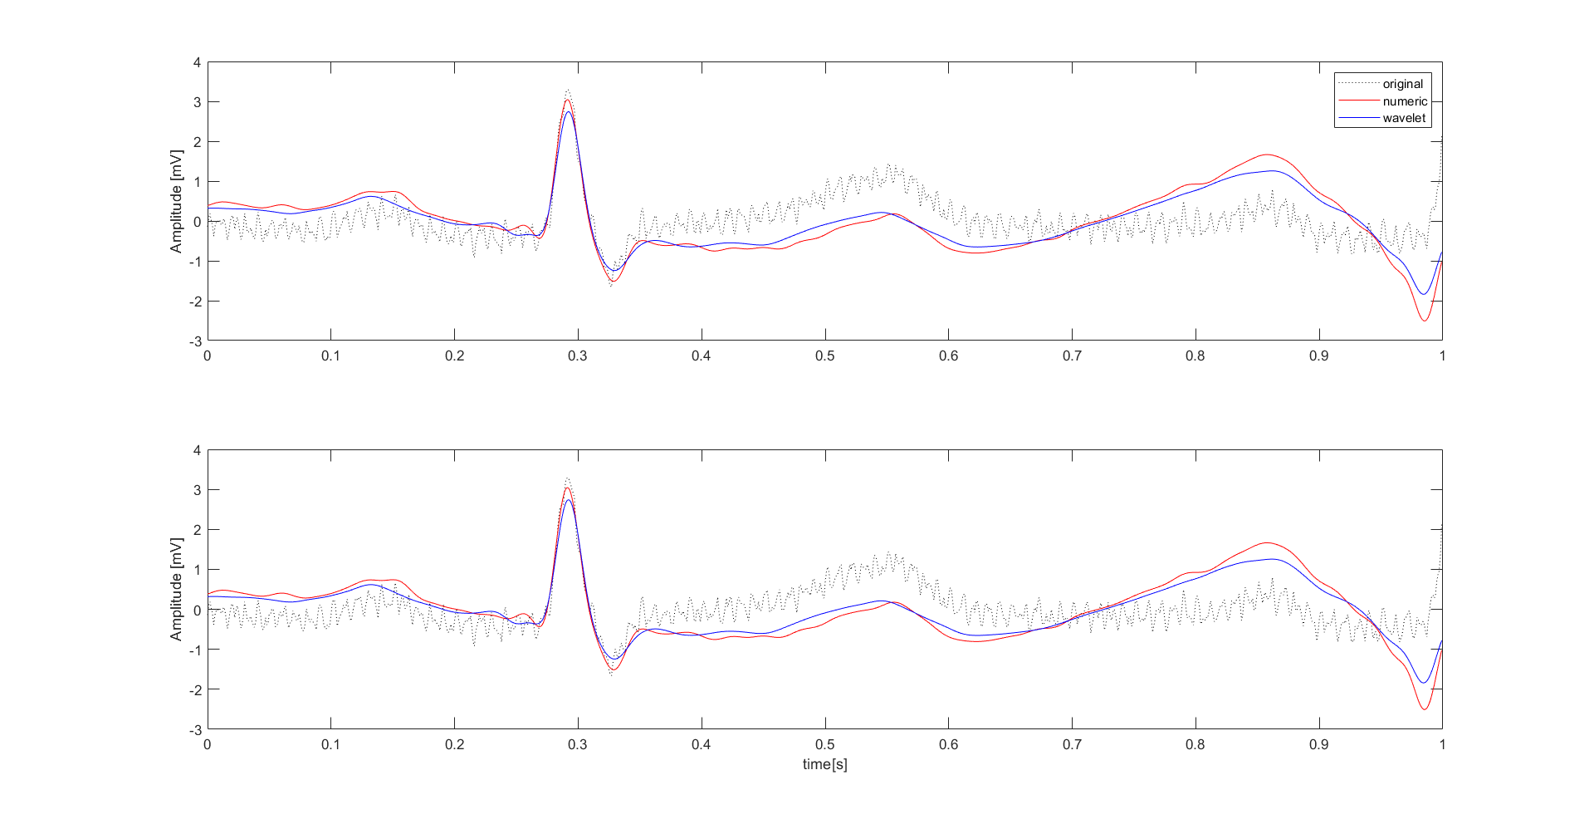
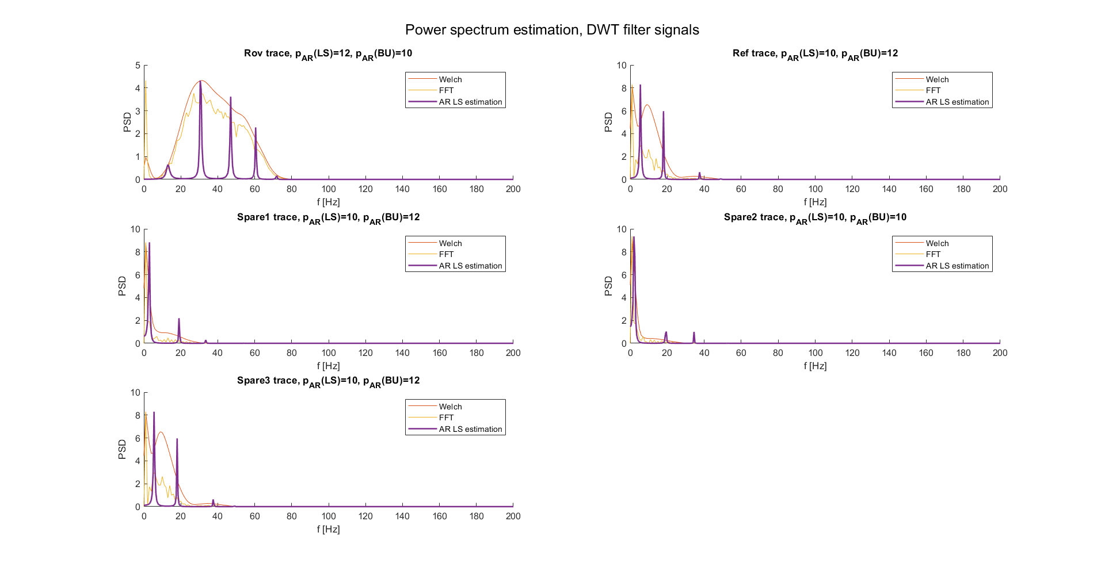
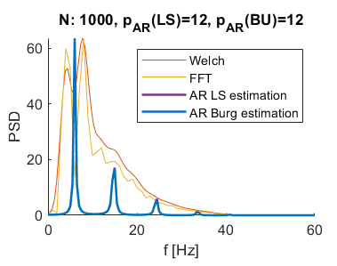
Spectrum estimation
Spectrum estimation is affected by filtering performances and estimation method. As know from previous steps:
LS estimation provides spectrums with high frequency resolution
Filters can be optimized (as done)
So, spectrum estimation pipeline was applied on filtered signals.
First on a single beat ECG (compared with the previous obtained results)
Then on records examples (Rov, Ref…)
Performance are satisfying, but this is just one example. It’s possible that in the next steps data will require scaling (i.e., min-max scaling) to ensure comparable spectrums.
Should be noted that these results allow to clearly distinguish signals (not only between Rov traces and others, but even between possibly different References).
DWT thresholding and BP filter
AR order estimation using nAIC criterion
AR spectrum estimation using LS estimator
Signal
AVNRT record
Didactical HF example

Slide 8
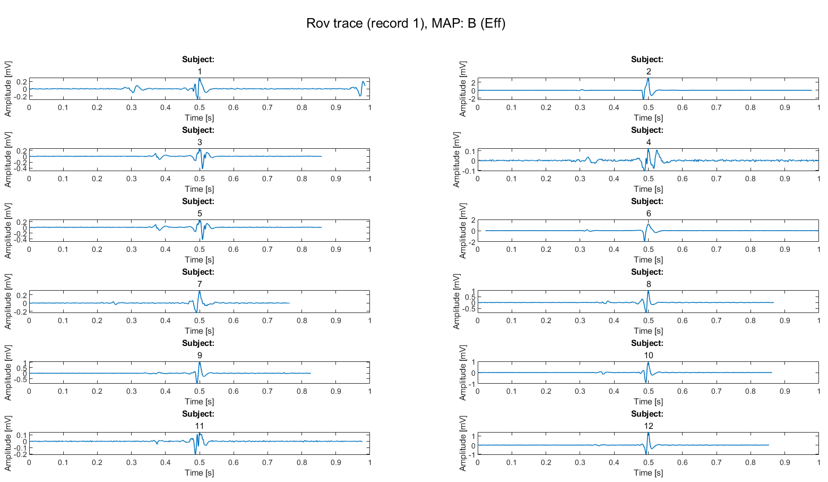
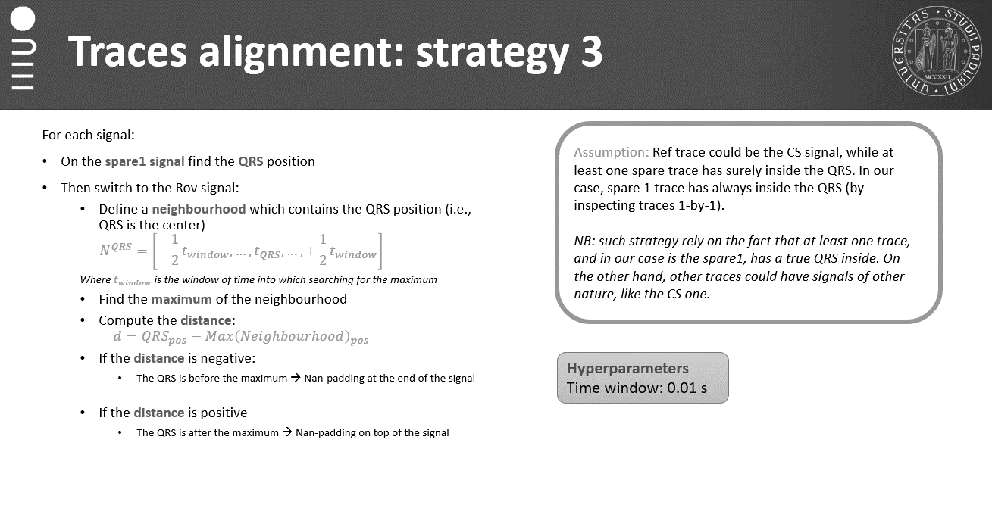
Alignment results
As observed previously, the best alignment strategy (under strong assumptions) was:
Find QRS into spare 1
Define the neighborhood into Rov trace around QRS point
Find the maximum into Ref neighborhood: Fiducial Point.
Aling the FC respect to the QRS.
Such strategy performs well on single subjects, but what if all Fiducial points found would be aligned respect to a common point? (i.e., half trace, 0.5 seconds).
The implemented strategy allow not only to align traces, but even with clear interpretability of traces peaks, leading to the possibility of repeating population analysis.

Slide 9
Further steps
Further steps from now on could be:
Remaking population analysis
Is it necessary to scale data?
Which are the common patterns?
Which are the differences, if observable, between maps?
Building a robust feature extraction pipeline
Which features are used in ECG single beat classification tasks?
Which of them could be used in our case?
Then proceeding with a supervised model evaluation
Which are the most common strategies used in similar tasks?
Supervised or unsupervised models? Other?

Slide 10
Outline
Recap of methods studied so far
Application on AVNRT data
ECG filtering
Spectrogram estimation
Alignment results
Further steps
Other possible routes: Scalogram
Theory
Application on didactical examples
Application on AVNRT data
Conclusions

Slide 11
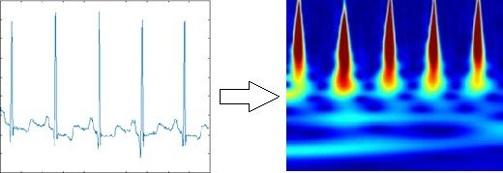
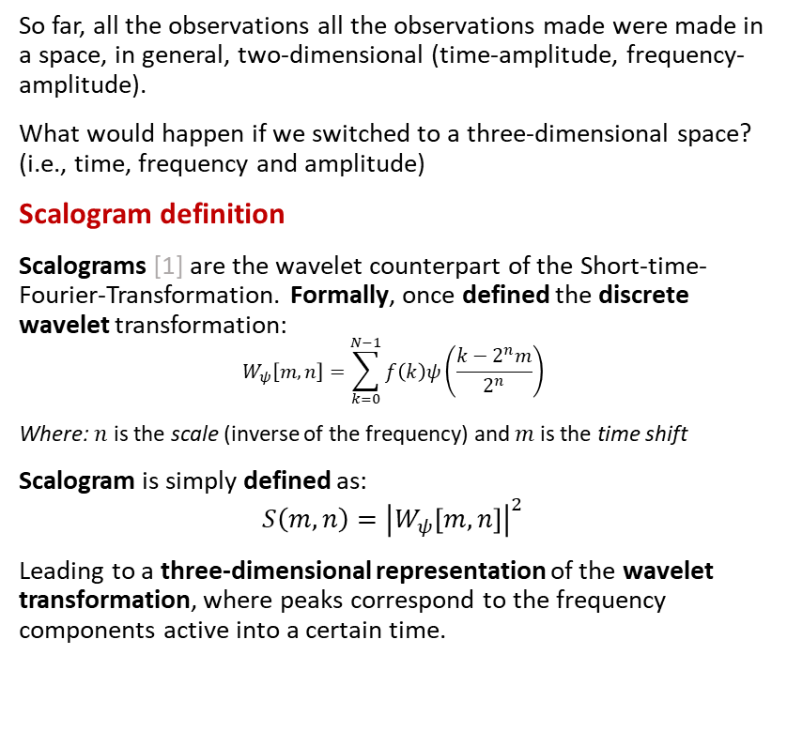
Scalogram: theory
So far, all the observations all the observations made were made in a space, in general, two-dimensional (time-amplitude, frequency-amplitude).
What would happen if we switched to a three-dimensional space? (i.e., time, frequency and amplitude)
Scalogram definition
Scalograms [1] are the wavelet counterpart of the Short-time-Fourier-Transformation. Formally, once defined the discrete wavelet transformation:
$$W_{ψ}\left[m,n\right]=\sum_{k=0}^{N−1}{f\left(k\right)ψ\left(\frac{k−2^{n}m}{2^{n}}\right)}$$
Where: $n$ is the scale (inverse of the frequency) and $m$ is the time shift
Scalogram is simply defined as:
$$S\left(m,n\right)={\left|W_{ψ}\left[m,n\right]\right|}^{2}$$
Leading to a three-dimensional representation of the wavelet transformation, where peaks correspond to the frequency components active into a certain time.
1. J. Bialasiewicz, "Application of Wavelet Scalogram and Coscalogram for Analysis of Biomedical Signals," Proceedings of the Conference, July 2015.

Slide 12
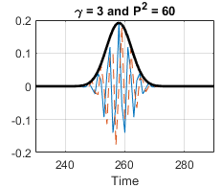
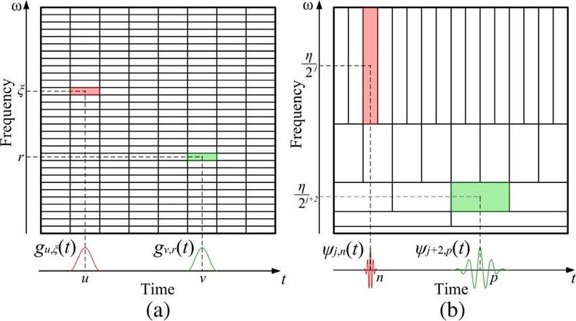
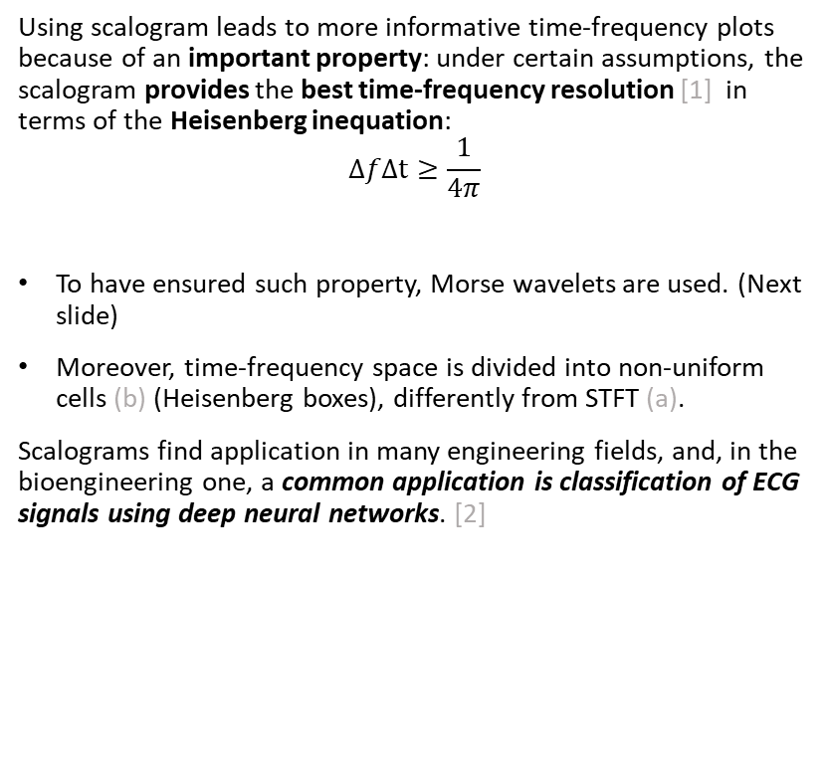
Scalogram: theory
Using scalogram leads to more informative time-frequency plots because of an important property: under certain assumptions, the scalogram provides the best time-frequency resolution [1] in terms of the Heisenberg inequation:
$$ΔfΔt≥\frac{1}{4π}$$
To have ensured such property, Morse wavelets are used. (Next slide)
Moreover, time-frequency space is divided into non-uniform cells (b) (Heisenberg boxes), differently from STFT (a).
Scalograms find application in many engineering fields, and, in the bioengineering one, a common application is classification of ECG signals using deep neural networks. [2]
2. Daydulo, Y.D., Thamineni, B.L. & Dawud, A.A. Cardiac arrhythmia detection using deep learning approach and time frequency representation of ECG signals. BMC Med Inform Decis Mak 23, 232 (2023).

Slide 13
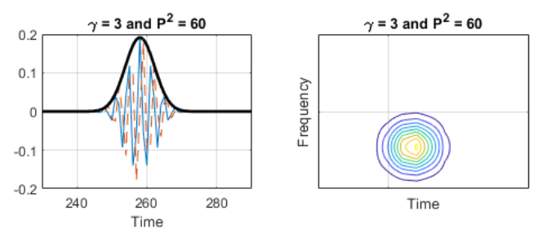
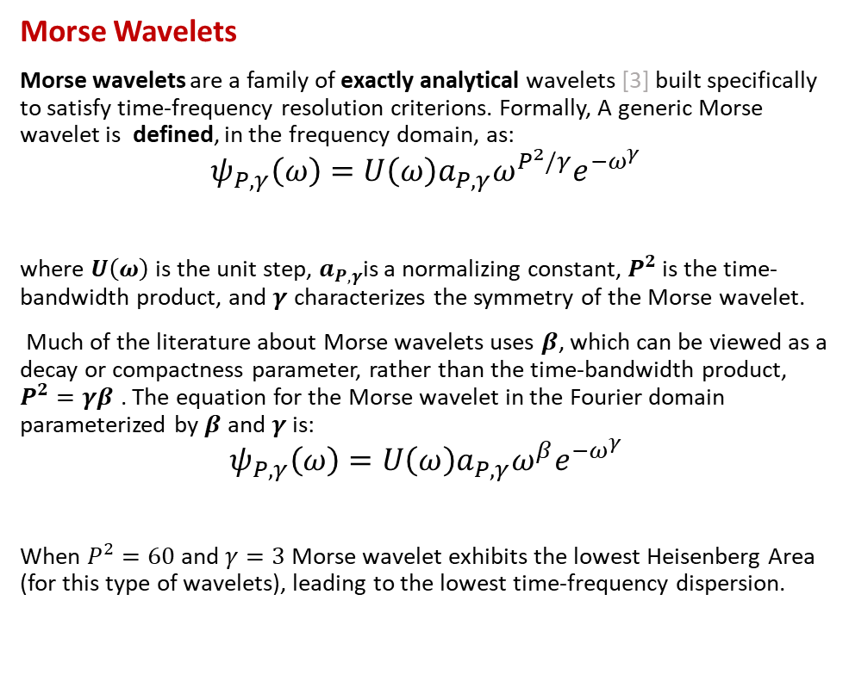
Scalogram: theory
Morse Wavelets
Morse wavelets are a family of exactly analytical wavelets [3] built specifically to satisfy time-frequency resolution criterions. Formally, A generic Morse wavelet is defined, in the frequency domain, as:
$$ψ_{P,γ}\left(ω\right)=U\left(ω\right)a_{P,γ}ω^{P^{2}/γ}e^{−ω^{γ}}$$
where $U\left(ω\right)$ is the unit step, $a_{P,γ}$is a normalizing constant, $P^{2}$ is the time-bandwidth product, and $γ$ characterizes the symmetry of the Morse wavelet.
Much of the literature about Morse wavelets uses $β$, which can be viewed as a decay or compactness parameter, rather than the time-bandwidth product, $P^{2}=γβ$ . The equation for the Morse wavelet in the Fourier domain parameterized by $β$ and $γ$ is:
$$ψ_{P,γ}\left(ω\right)=U\left(ω\right)a_{P,γ}ω^{β}e^{−ω^{γ}}$$
When $P^{2}=60$and $γ=3$ Morse wavelet exhibits the lowest Heisenberg Area (for this type of wavelets), leading to the lowest time-frequency dispersion.
3. S. C. Olhede and A. T. Walden, "Generalized Morse wavelets," in IEEE Transactions on Signal Processing, vol. 50, no. 11, pp. 2661-2670, Nov. 2002, doi: 10.1109/TSP.2002.804066.

Slide 14
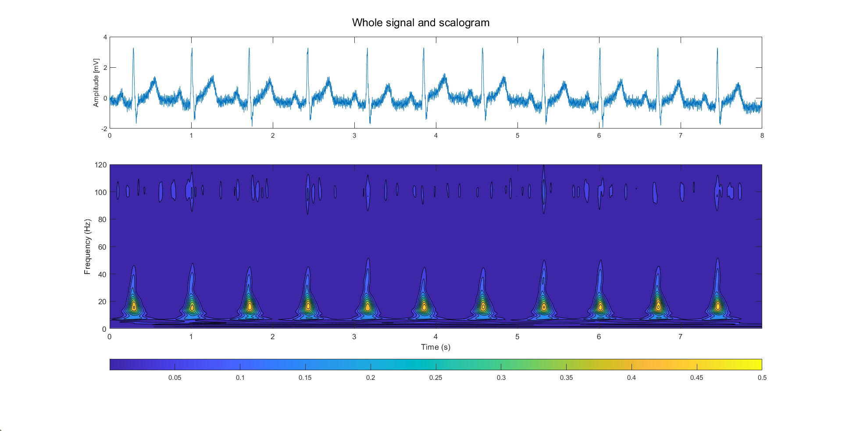
Scalogram: application on external data
Scalogram evaluation can be done directly on ECG signals without filtering, at least to begin.
So, the evaluation pipeline is made of these steps:
Perform DWT on the signal
Transforms coefficients using the scalogram definition
Plot the result
It’s reported an example of scalogram, related to a High frequency noise ECG signal (the well-known didactical one), It’s possible to recognize:
Single beats
Noise presence
Obviously, the scalogram of a signal could be computed after filtering to put in evidence the energy peaks really related to the signal itself.

Slide 15
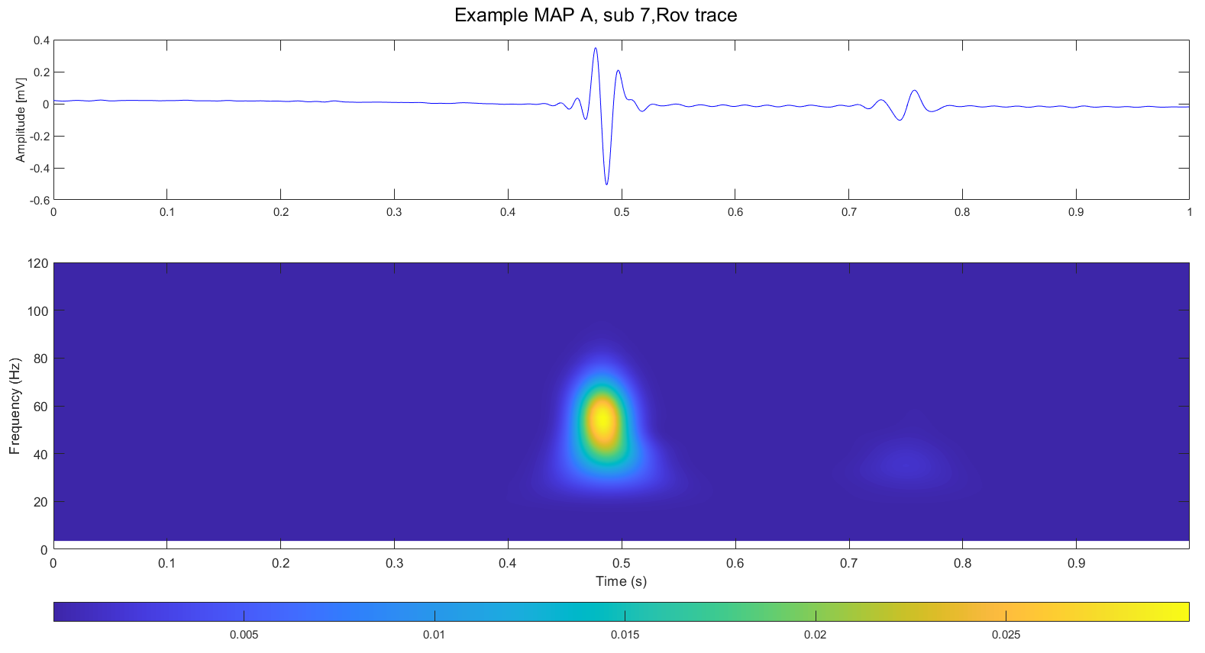
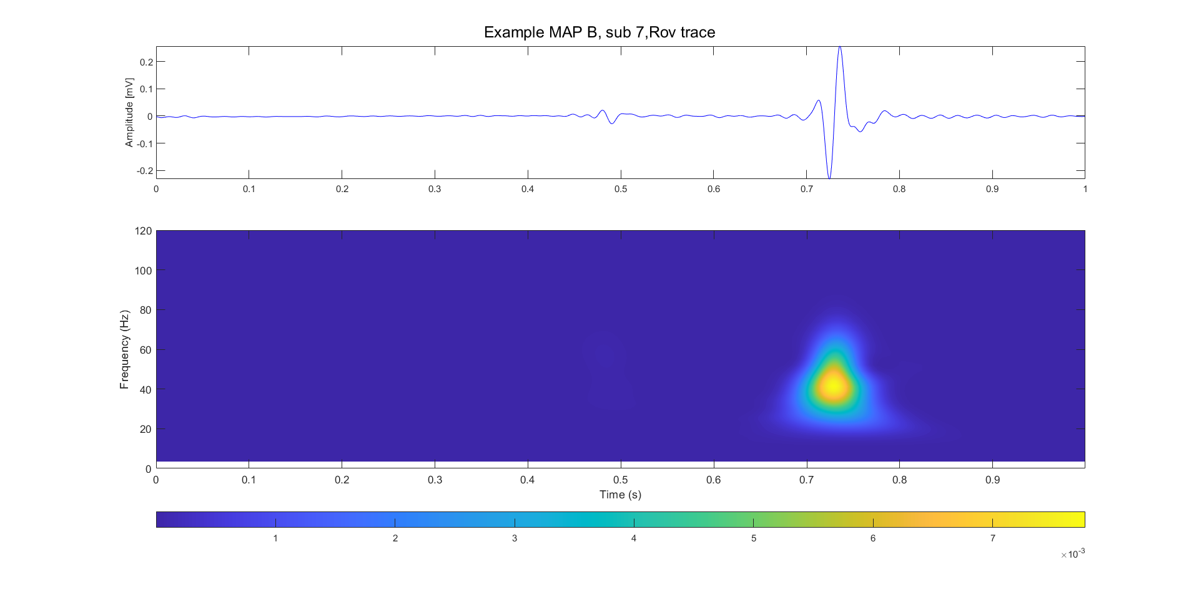
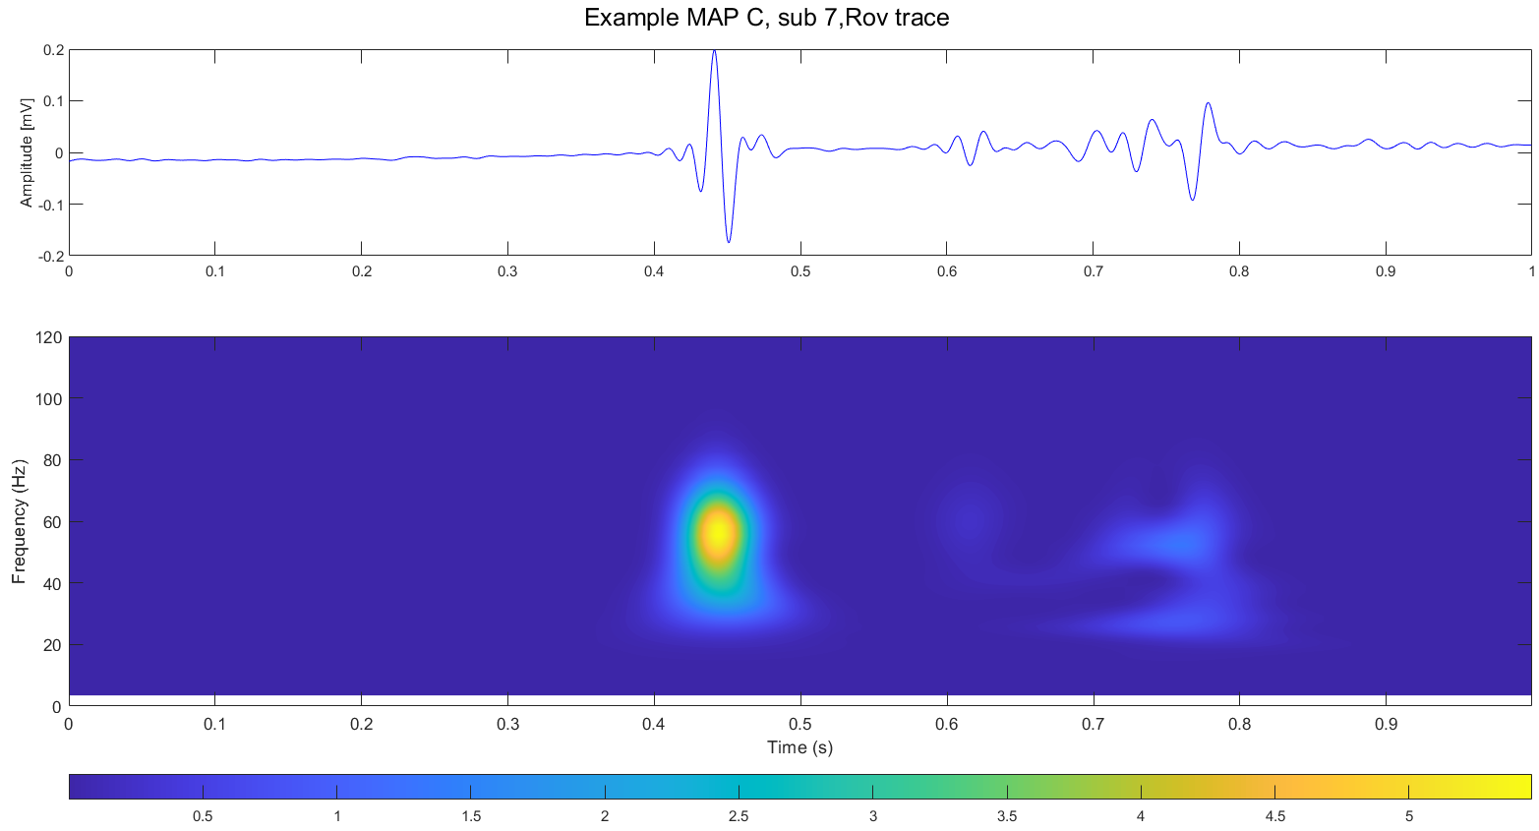
Scalogram: application AVNRT data
Finally, scalogram evaluation pipeline could be applied on AVNRT data to find out if there are observable differences between maps into time-frequency plane.
Here are reported, for the same subject (7), three scalogram:
Rov trace, record 1, MAP A (indifferent)
Rov trace, record 1, MAP B (effective)
Rov trace, record 1, MAP C (dangerous)
All these traces have been filtered and have zero mean.
As can be seen, there are some differences into these scalograms, possibly related to the map.
Again, this is just a single example, probably data require to be scaled to be comparable.
Atrial
Ventricular
His’ bundle

Slide 16
Conclusions
Previously studied methods leads to encouraging results:
Mixed strategy of filtering: with minor differences respect to the original pipeline, the performance are satisfactory.
Spectrum evaluation pipeline: results on single beat comparable with didactical examples and good frequency resolution overall. It’s possible that further steps will require data rescaling.
Moreover, the possibility of using scalogram as time-frequency representations of AVNRT signals it has been explored. First results in this way are encouraging, with observable differences between maps, but more analysis should be done, even with data rescaling.
Next steps could be, in order:
Building population dataset
Remaking population analysis
Deciding a pool of features to use on AVNRT data
Extract features from AVNRT data
Starting developing a ML model

Slide 17
References
J. Bialasiewicz, "Application of Wavelet Scalogram and Coscalogram for Analysis of Biomedical Signals," Proceedings of the Conference, July 2015.
Daydulo, Y.D., Thamineni, B.L. & Dawud, A.A. Cardiac arrhythmia detection using deep learning approach and time frequency representation of ECG signals. BMC Med Inform Decis Mak 23, 232 (2023).
S. C. Olhede and A. T. Walden, "Generalized Morse wavelets," in IEEE Transactions on Signal Processing, vol. 50, no. 11, pp. 2661-2670, Nov. 2002, doi: 10.1109/TSP.2002.804066.

